Slide 1
Passkeys
Security – Passkeys in Django
Your Passwordless future
Makai Kahilu

Slide 2
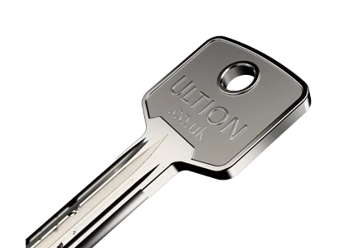
Security – Physical World

Slide 3
Authentication
Who are you? | Prove it.

Slide 4
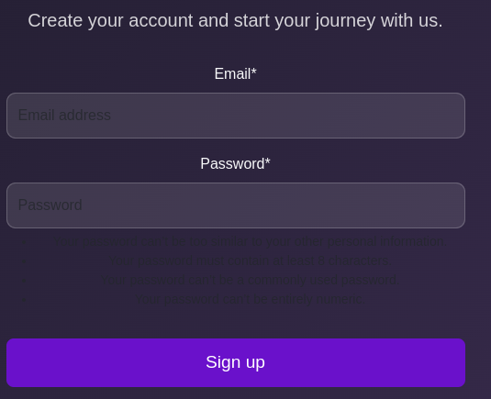
Security – Digital World
- Real-world applications
- Why Python is the best choice

Slide 5
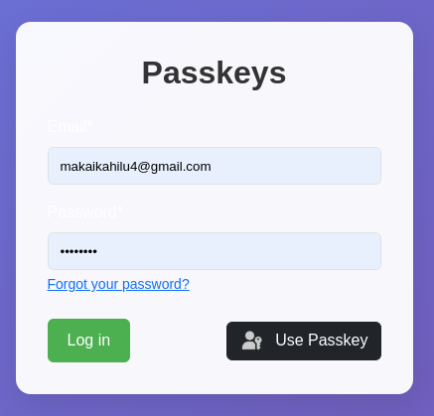
lications
- Why Python is the best choice

Slide 6

Troubles with Passwords

Slide 7
Problems with Passwords
Unique - Credential Stuffing
Complex - Remember?
Fresh - Guessable
Don’t click on links – Phishing
Hashed + Salted - Replayed
Helpful Solutions
Password Managers
Multi-factor authentication
Single Sign-On

Slide 8
Truth: Passwords are a liability to both developers & Users
Passkeys
WebAuth
FIDO - 2013
+250 Organisations
?

Slide 9
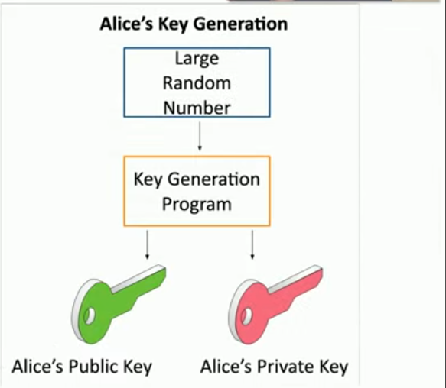
Public Key Cryptography

Slide 10
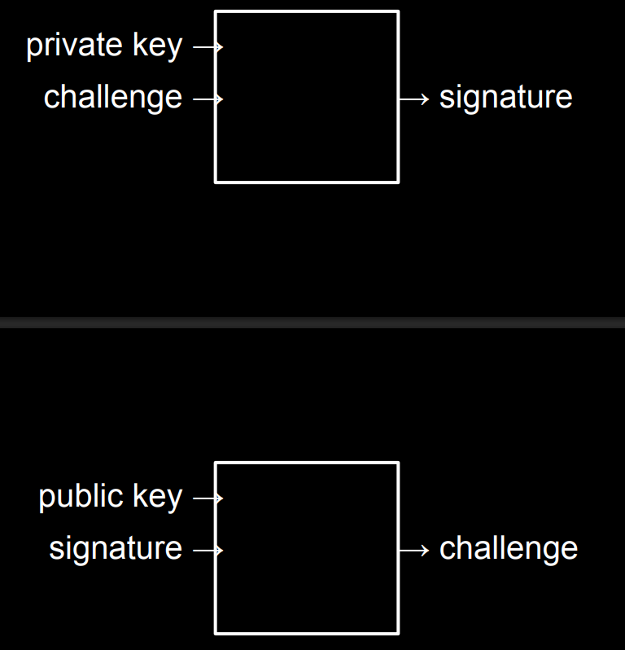

Slide 11


We want to be happy
-Security, Usability & business

Slide 12
Big Question: Integrate into Django?
django-webauthn
Django-passkeys - demo
django-fido2
django-mfa2
wagtail-passkeys

Slide 13
Django-passkeys : Checklist
Pip nstall django-passkeys
Pip freeze > requirements.txt
Import & add “passkeys” settings.py
Tweak “AUTHENTICATION_BACKENDS” to allow passkeys
Tweak passkey server – settings.py
Wire in the url – in project’s urls.py
Add “passkeys.js” to login.html
Other conditional UIs, if you need them.

Slide 14
Let us go for a Spin
Did we break our app or It is still working?
Let us try to click on “use passkey” button
I Promised - Passkeys into Django, check mark?

Slide 15
Resources
Django-passkeys: https://github.com/mkalioby/django-passkeys
Beginner: https://developers.google.com/identity/passkeys/
Learn: https://www.passkeys.com/what-is-webauthn
Learn: https://www.passkeycentral.org/introduction-to-passkeys/how-passkeys-work

Slide 16


Slide 17
Thank you
X : @makaiJnr
Github: https://github.com/makai77

